Slide 1
Year 2 Work Pack w/b 15th June

Slide 2
Online Resources
The BBC and National Oak Academy have launched daily age appropriate lessons to support you whilst home learning. There will be new English and maths lessons released daily from both websites, as well as other curriculum areas, based on Year 2 curriculum content. Lessons that have already been taught will remain available on the website.
https://www.bbc.co.uk/bitesize/tags/z7s22sg/year-2-lessons/1
https://www.thenational.academy/online-classroom/year-2/#schedule

Slide 3
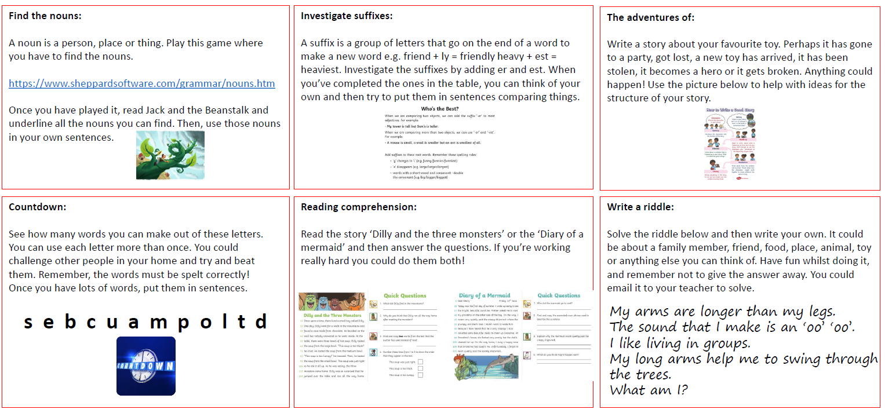
English Home Learning Activities w/b 15th June
In addition to practising your Common Exception Word spellings and reading daily, choose three of these writing activities to complete to complete this week.

Slide 4
Maths Home Learning Activities w/b 15th June
In addition to 10+ minutes of TT Rockstars/Numbots daily practice, choose three of these Maths activities to complete.

Slide 5
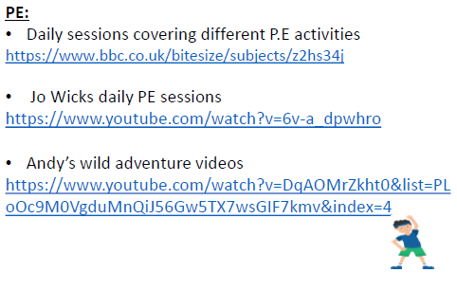
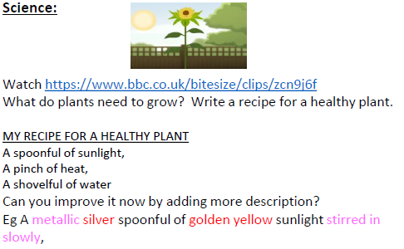
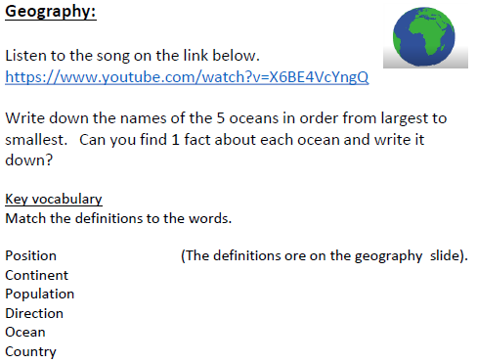
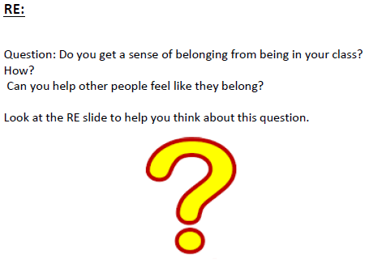
Non-Core Home Learning Activities 15th June
Complete a PE activity daily and choose at least one other to complete a week.

Slide 8
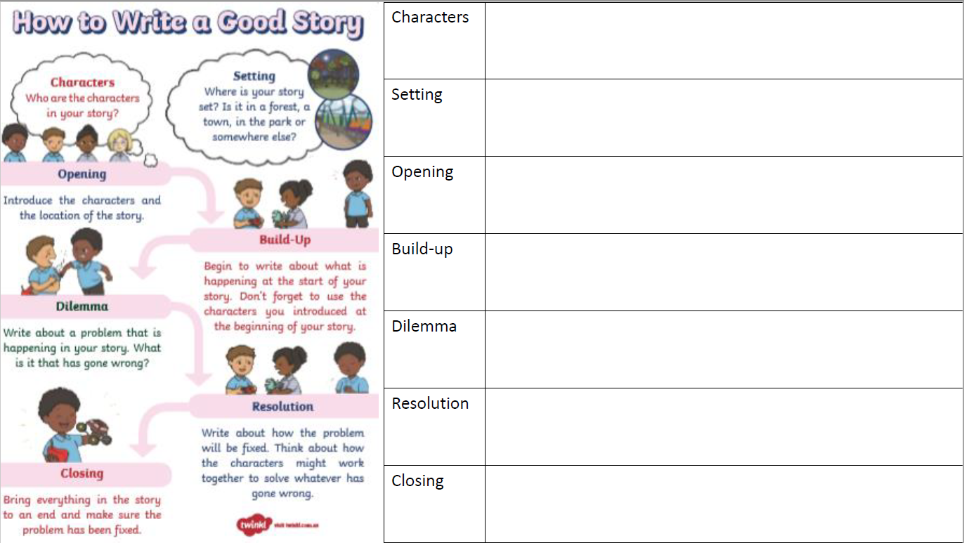

Slide 14
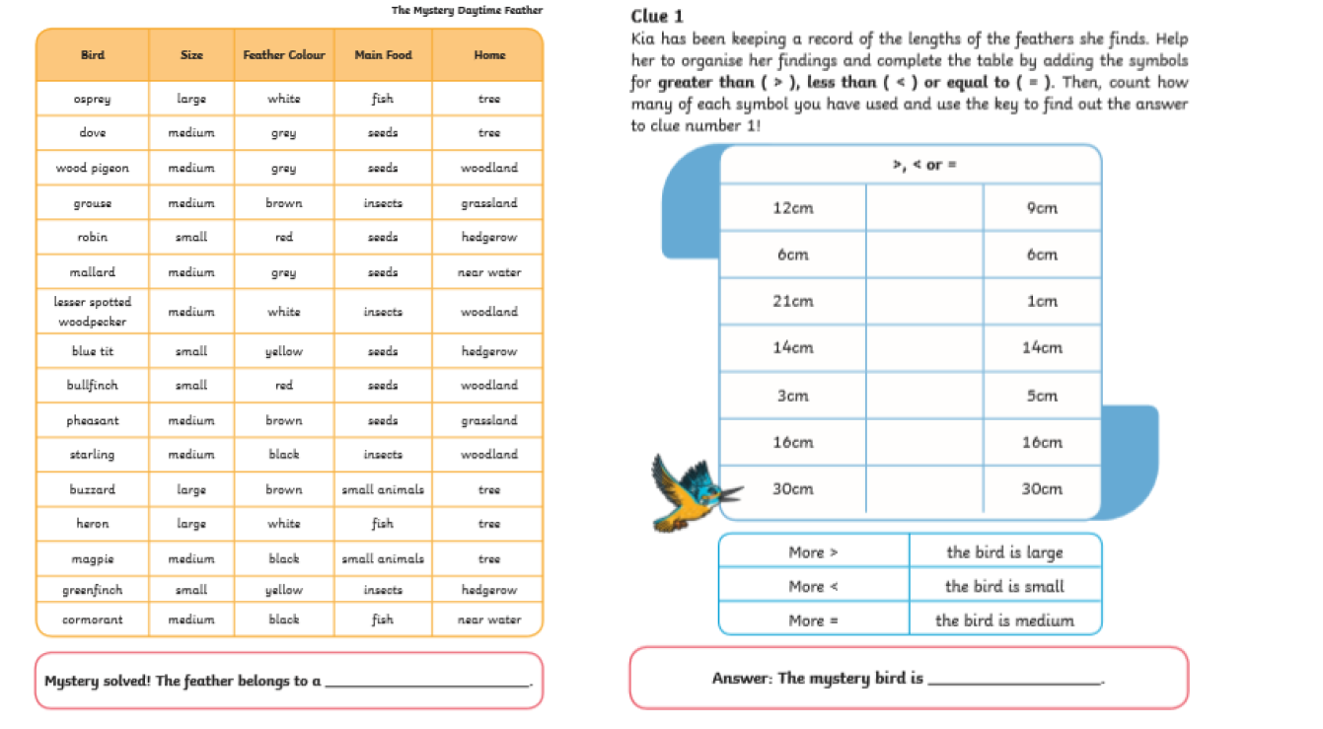

Slide 15
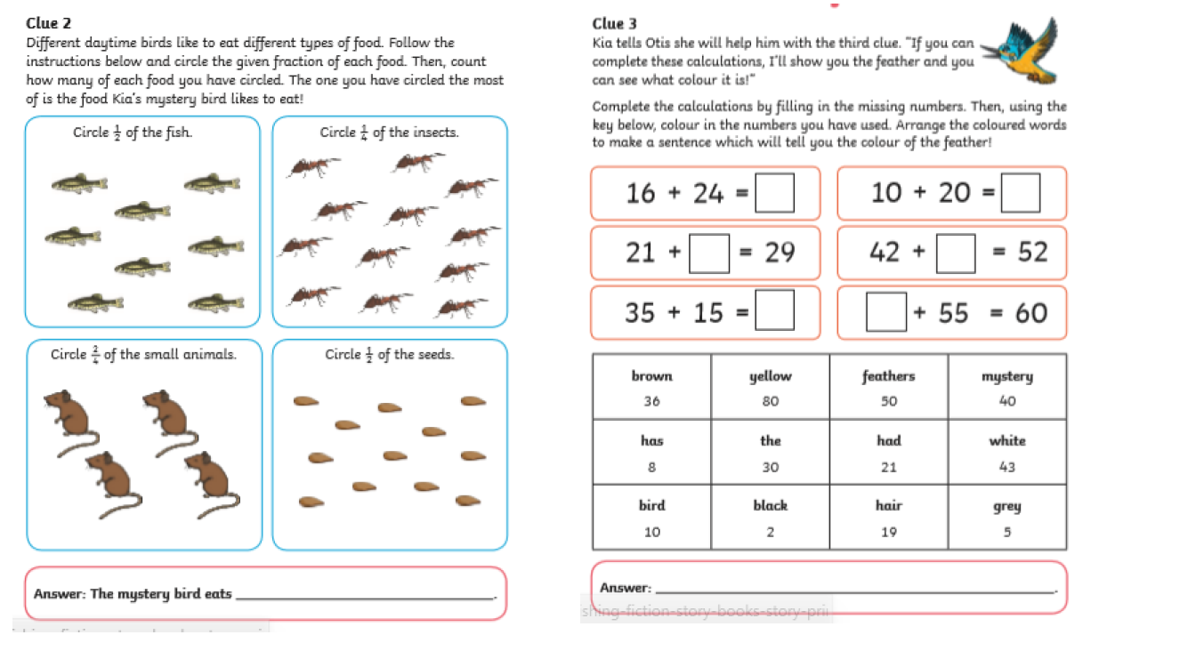

Slide 20
