Slide 1
Year 2 Work Pack w/b 8th June

Slide 2
Online Resources
The BBC and National Oak Academy have launched daily age appropriate lessons to support you whilst home learning. There will be new English and maths lessons released daily from both websites, as well as other curriculum areas, based on Year 2 curriculum content. Lessons that have already been taught will remain available on the website.
https://www.bbc.co.uk/bitesize/tags/z7s22sg/year-2-lessons/1
https://www.thenational.academy/online-classroom/year-2/#schedule

Slide 3
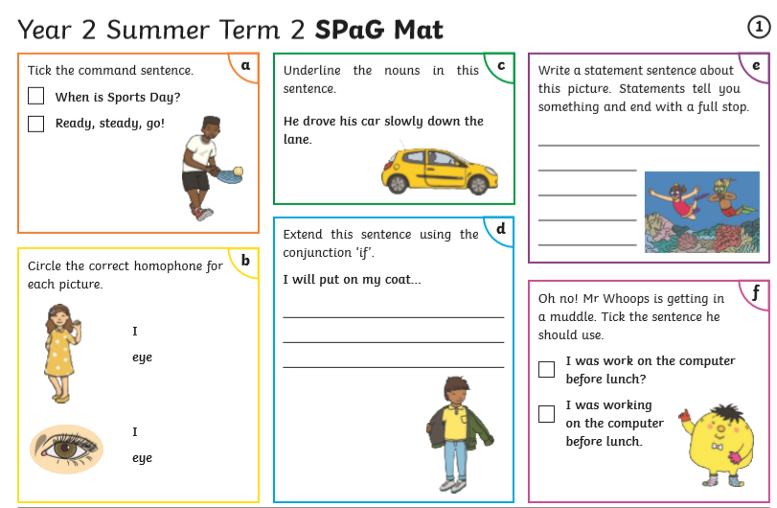
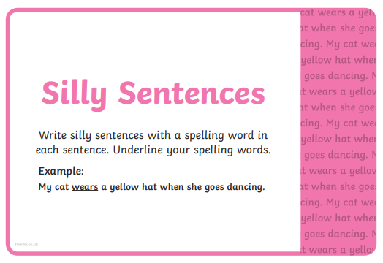
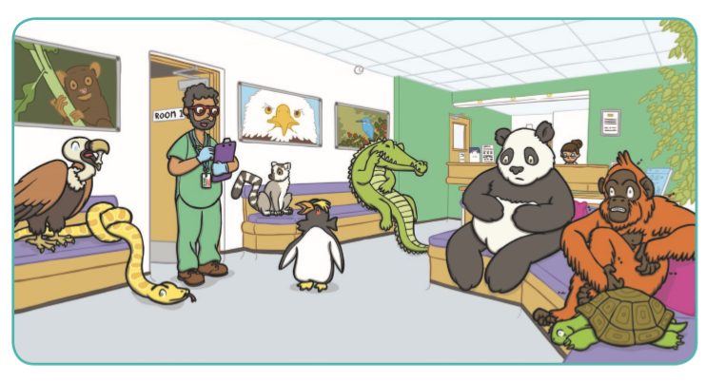
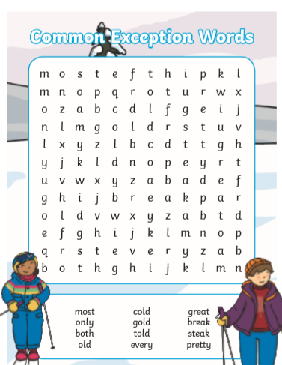
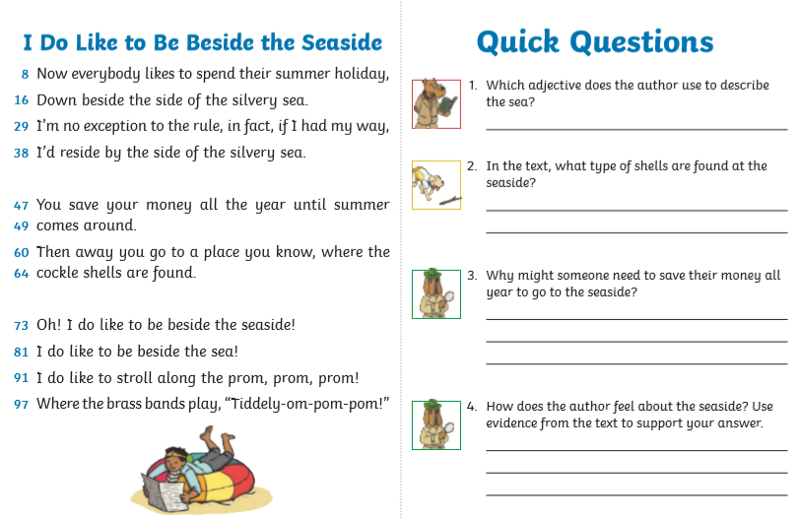
English Home Learning Activities w/b 8th June
In addition to practising your Common Exception Word spellings and reading daily, choose three of these writing activities to complete to complete this week.
SPAG mat:
Complete the activities on the SPAG mat. Can you remember what different sentence types there are?
Silly sentences:
Choose 10 of the common exception words from the slide. Write a silly sentence for each. Can you write a silly sentence with two of the words in?
What happened next ?
The Zoo vet
What do you think happened next at the zoo vet’s surgery? Write your own story about what was wrong with each new patient and how the vet helped them.
Acrostic:
See if you can find all the words in the word search. Good luck!
Reading comprehension:
Read the text ‘Diary of a vet’ or ‘ I do like to be beside the seaside’ and then answer the questions. If you’re working really hard you could do them both!
Story setting description:
Watch the clip and write about the girls adventure. Make sure that you include lots of description.
https://www.literacyshed.com/something-fishy.html

Slide 4
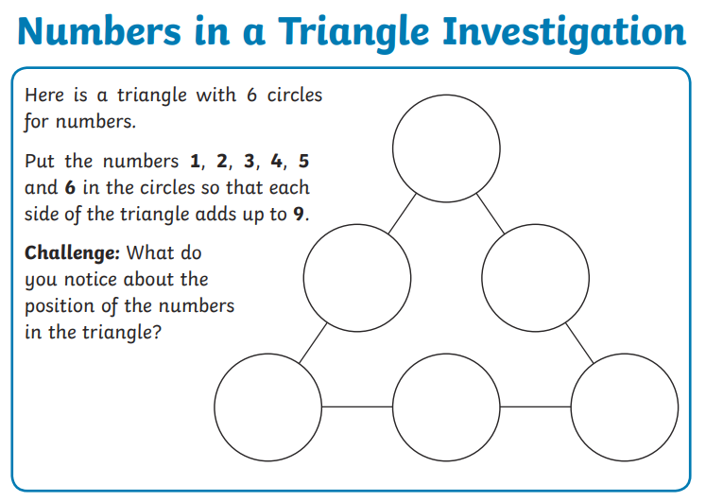
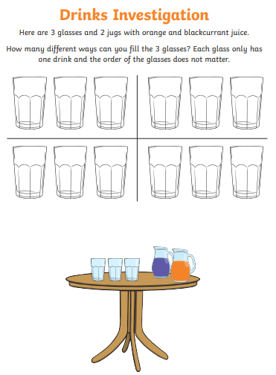
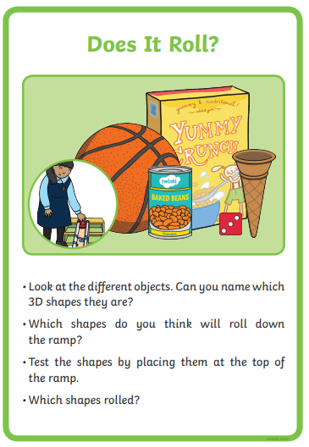
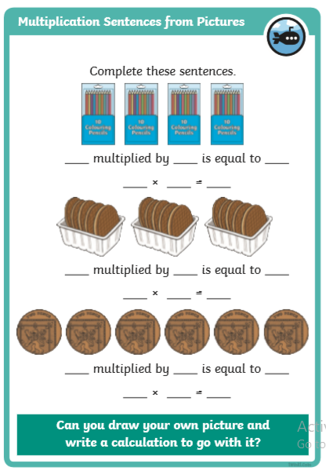
Maths Home Learning Activities w/b 8th June
In addition to 10+ minutes of TT Rockstars/Numbots daily practice, choose three of these Maths activities to complete.
Drinks investigation
Triangle investigation
Can you complete the 9 questions on the sheet below?
These are practicing addition and subtraction.
They also include questions of things we have covered in Year 2.
3D shapes
Find some items that are 3D shapes eg a tin of beans. See if they roll down the ramp. The ramp could be a large book of a piece of wood.
Multiplication time
Look at the pictures and complete the multiplication sentences. Then draw your own pictures and write calculations for them.
Work out the clues to solve the mystery. Who is the door slamming culprit?

Slide 5
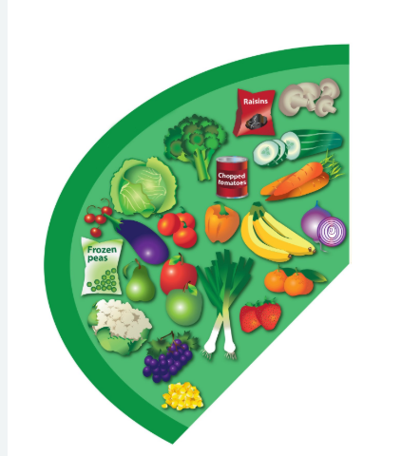
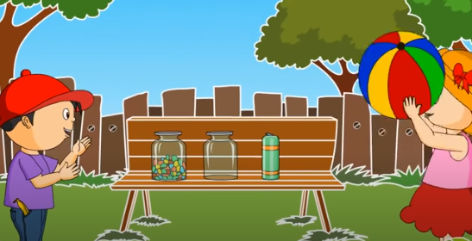
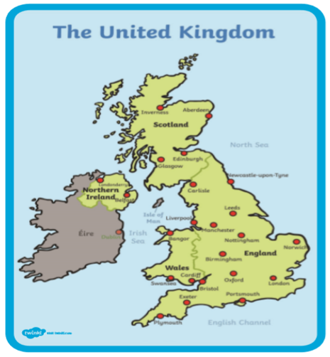
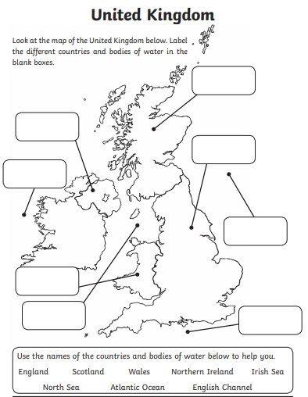
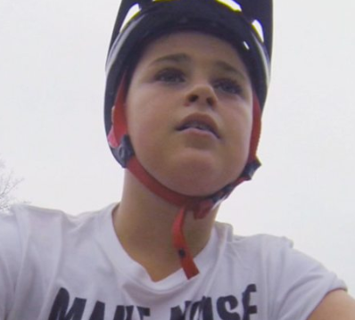
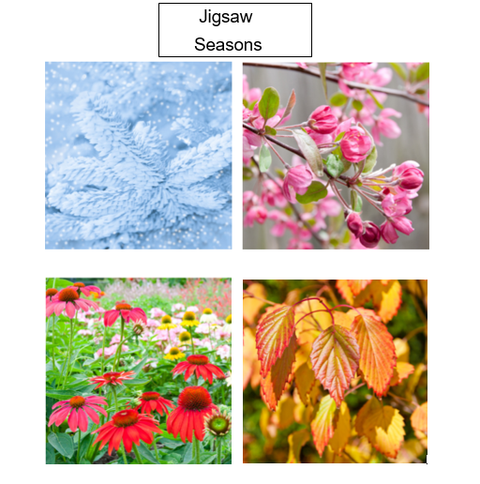
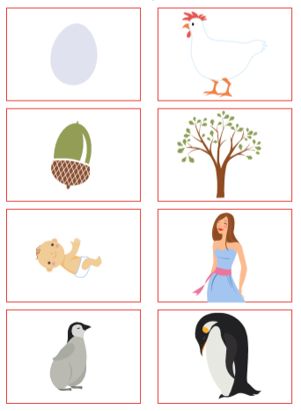
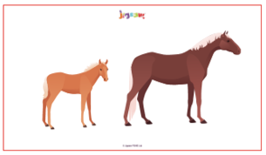
Non-Core Home Learning Activities 8th June
Complete a PE activity daily and choose at least one other to complete a week.
PE:
Look at the PE sessions on the Year 2
Jo Wicks daily PE sessions
https://www.youtube.com/watch?v=6v-a_dpwhro
10 daily activities to do at home
https://www.youtube.com/watch?v=h3Xrtm0IVnY
Science:
Find out about and describe the basic needs of animals, including humans, for survival (water, food and air)
Watch:
https://www.youtube.com/watch?v=wOXay8rdzRg
Make a poster showing what living things needs to survive.
Art and DT:
Cooking around the world
Watch the link:
https://www.nhs.uk/live-well/eat-well/the-eatwell-guide/
Plan a healthy meal that you and your family would enjoy. You could even ask an adult if you could help make the meal. Think carefully about the size of the portions of the different food groups. You could draw a picture of your meal. Was it tasty? Which bit did you like the most? Would you make it again?
Music: Start singing
Bitesize lesson on how to warm up your voices ready to sing. Have fun!
https://www.bbc.co.uk/bitesize/articles/zr4nscw
PSHE/Jigsaw: Changing me
Look at the slides and think about how the things change. We will be thinking about how we change this week.
Geography:
Where do we live? What are the names of the countries in our island? Has anyone been to them?
.
Label a map of the U.K including capital cities and seas. Write facts about each country.
RE:
Judaism
Watch the clip and discuss what is important for Jewish people.
https://www.bbc.co.uk/programmes/p02mx8pg

Slide 7
Common exception words

Slide 15
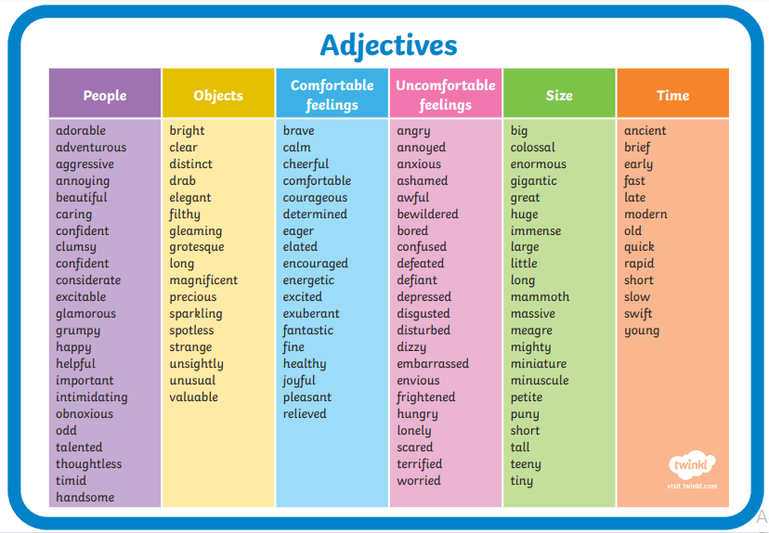

Slide 17
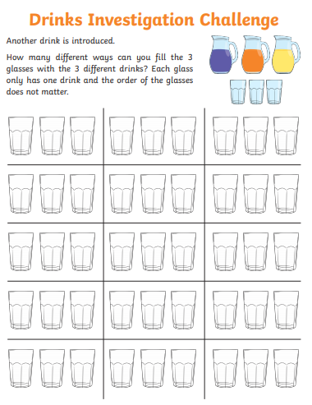

Slide 18
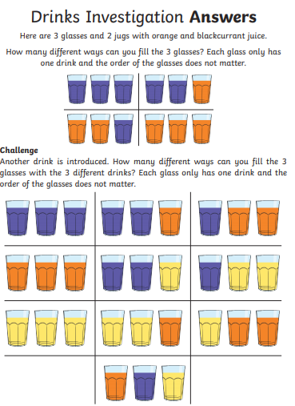

Slide 19
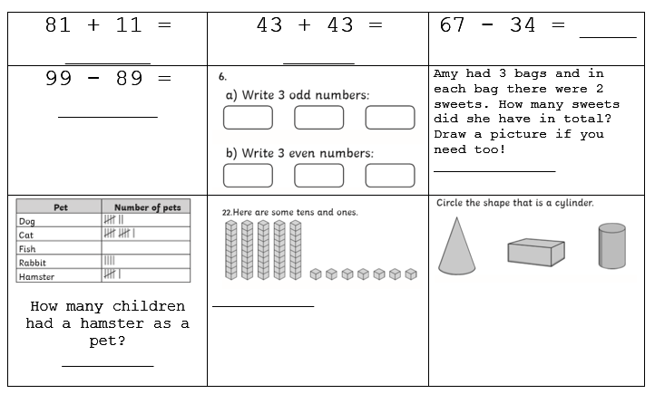

Slide 21
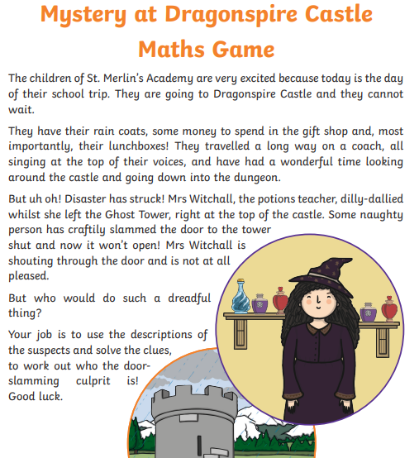

Slide 22
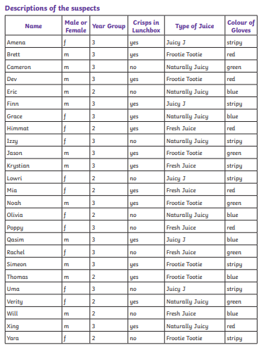

Slide 23
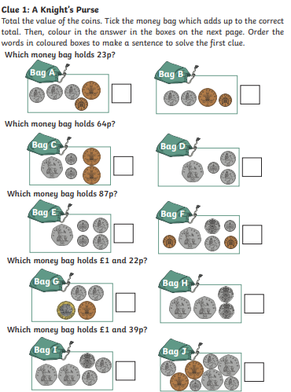

Slide 24
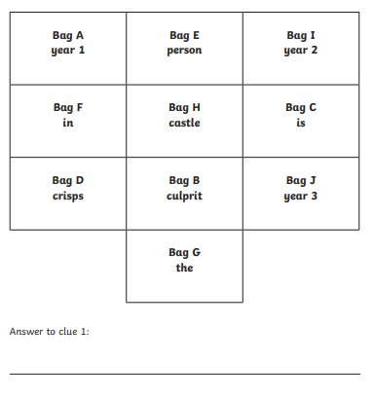

Slide 25
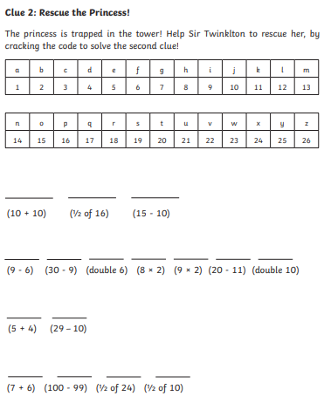

Slide 26
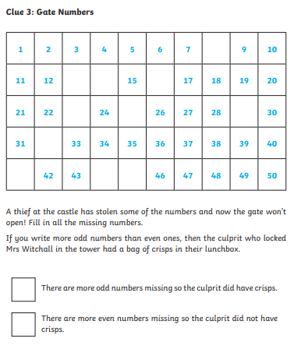

Slide 27
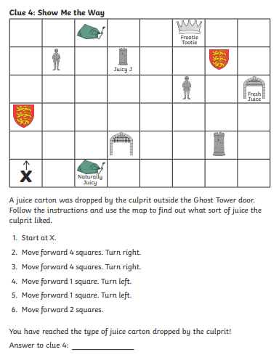

Slide 28
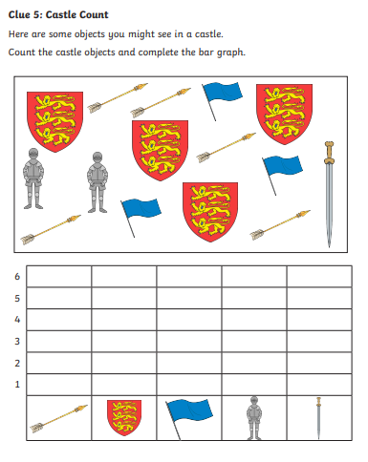

Slide 29
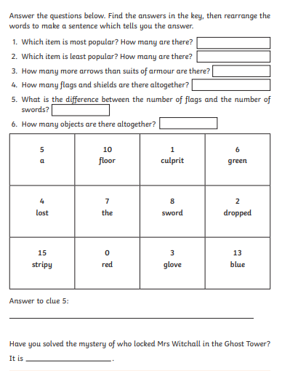

Slide 30
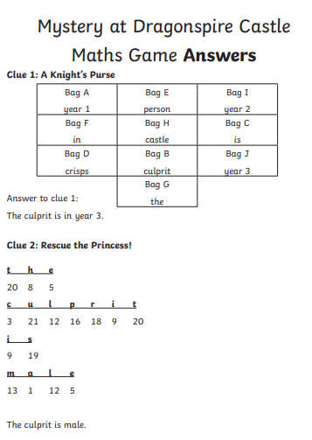
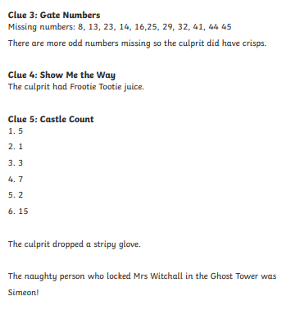

Slide 31
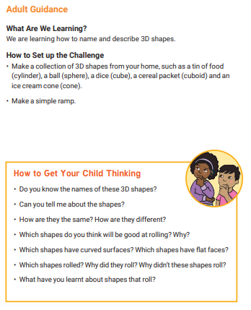

Slide 33
Science
Make a poster showing what living things needs to survive.
Do you think that animals need shelter, love, companions and warmth?
Although these things all make our lives easier and better we actually only essentially need 3 things to survive. We may want the others but they are not essential.
Discuss the questions below.
How long do you think we could survive with only food water and air?
What might happen if we ONLY ever had these 3 things?
How important are these other things?

Slide 34
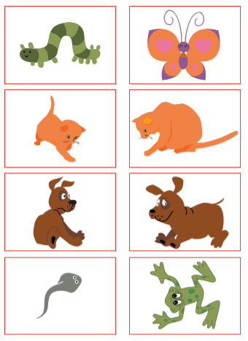
Jigsaw
Look at
the
Pictures
to see
the
change
from
baby
to adult.

Slide 35
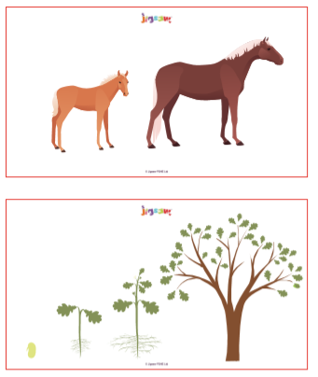
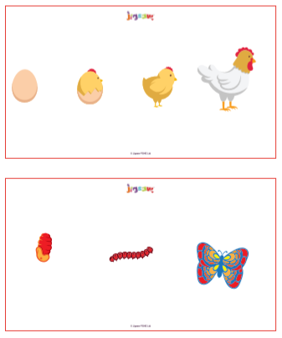
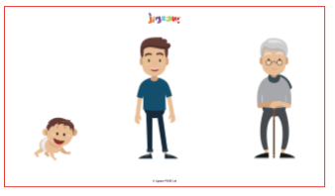
Jigsaw
Choose one life cycle from the images and to draw the egg/baby/seed/infant and how it changes to become an adult or fully grown. Label your pictures and write a sentence to describe the changes.

Slide 36
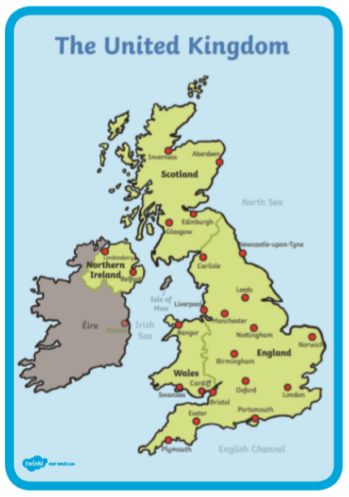
Geography

Slide 37
Geography
Also find and label the capital cities in the United Kingdom.
Research each country within the United Kingdom and write some facts about each.
https://kids.kiddle.co/Countries_of_the_United_Kingdom

